Slide 1
Digital Twins for logistics/transport optimization, using agent based modeling and data analytics
>李照 Andrea 11712606
>沈静然 Peter 11710116
>王炜皓 Mike 11710403

Slide 2
Digital Twin
A modeling and simulation idea: use simulator, and run algorithm based on real data, to measure how better the algorithm is.
Raised by Dr. Michael Grieves in 2003.
Reference: ridesharing platform of Cargo architecture.

Slide 3
School Bus Situation
School bus has constant route, but different time schedule can affect quality of service.
Problem: to dynamically arrange time schedule of school bus to satisfy the need of students.
Three part to solution: algorithm, simulator, data.
Constant: bus stops.

Slide 4
Why Do We Need Simulator
Use simulator to measure algorithm, determine how well it is.
Save a large number of time, saving cost of testing algorithm.
Find the best algorithm that satisfy the requirement.
Adjust the arguments in algorithm.
From evaluation to prediction!

Slide 5
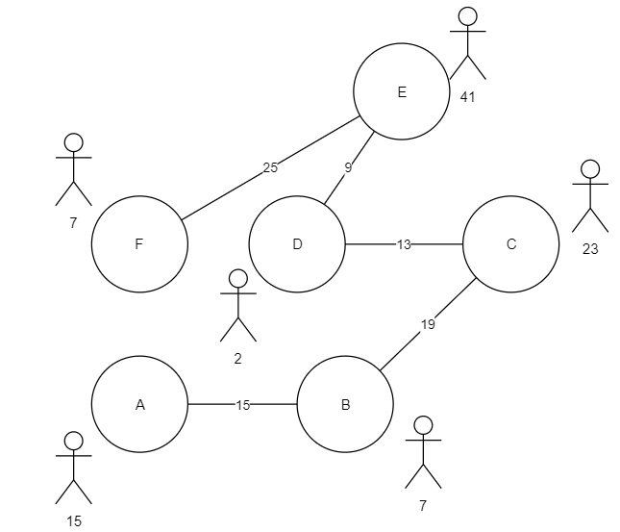
Problem instance

Slide 6
Problem instance
Station: some students are waiting in stations, waiting bus to reach their destination.
Edge: distance between stations, longer edge has longer time.
School bus running in graph to send all students to their destination.
Challenge: number of bus is limited, capacity of bus is limited.

Slide 7
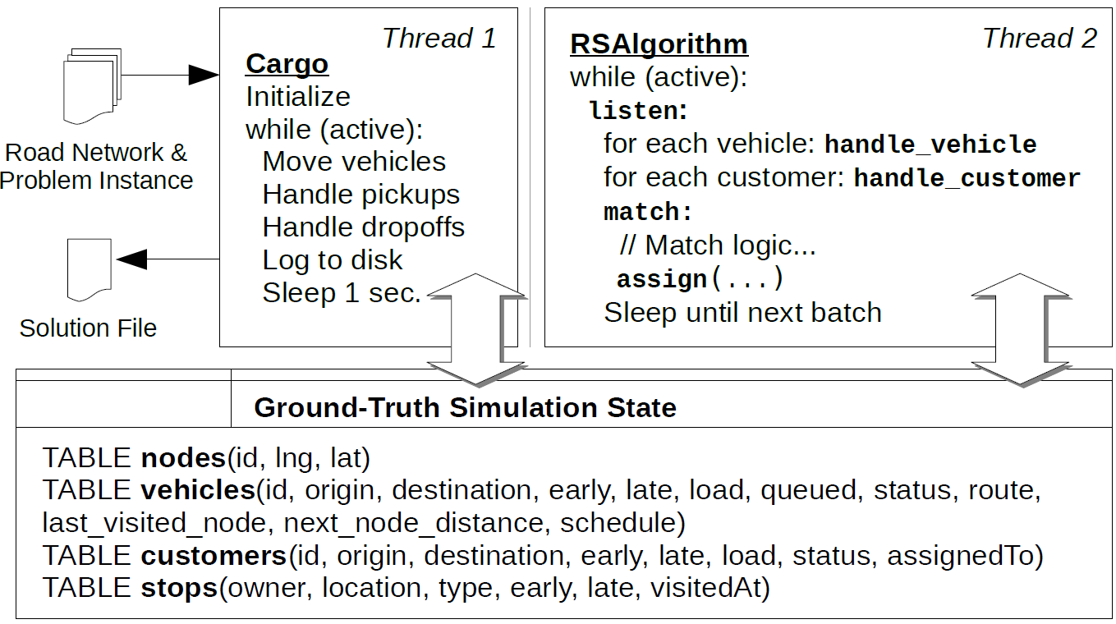
The cargo Algorithm
(VLDB2019)

Slide 8
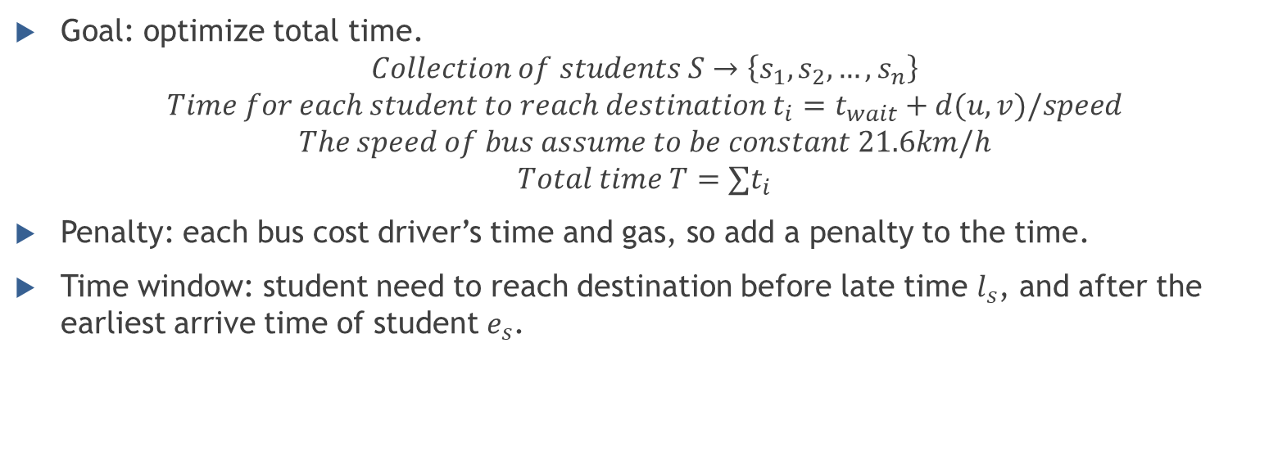
Another Step
Goal: optimize total time.
$$Collection of students S→\left\{s_{1}, s_{2}, …, s_{n}\right\}$$
$$Time for each student to reach destination t_{i}=t_{wait}+d(u, v)/speed$$
$$The speed of bus assume to be constant 21.6km/h$$
$$Total time T=∑t_{i}$$
Penalty: each bus cost driver’s time and gas, so add a penalty to the time.
Time window: student need to reach destination before late time $l_{s}$, and after the earliest arrive time of student $e_{s}$.

Slide 9

Algorithm Goal
Decide time to send bus;
Decide how long a bus is waiting in one stop;
Optimize total time plus penalty: $T=\left(∑s_{i}\right)+t_{penalty}$.
One parameter to adjust: penalty time.

Slide 10
Simulator Side
Measure an algorithm, according to evaluate several parts:
Total waiting time plus penalty;
Longest cost time;
Number of buses sent;
Percentage of students later than late time in time window.

Slide 11
Data of Simulator
Real data from school bus.
Data we need: Bus stops, number of students waiting for bus in each stop, course schedule of students (to decide time window), total number of buses.
Data sent to algorithm: bus stops, current number of students in each stop, course schedule, total number of buses.
Obvious we need an online algorithm!

Slide 12
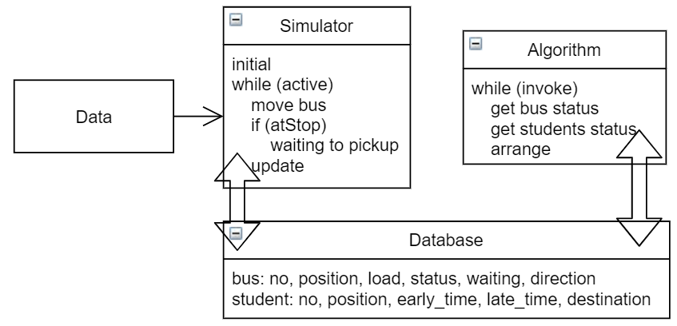
Our architecture

Slide 13
Comments
Simulator and algorithm are running together, which means there should be a synchronization between them.
Algorithm arrange 2 things: whether to send a new bus, and how long a bus should be waiting at a station.
Each bus has a capacity constant, means how many students it can carry. The load means current number of students on bus.
Simulator output a measurement of algorithm according to above 4 targets.

Slide 14
Motivation
Implement a simulator to simulate the bus system in SUSTech campus
Several utilizations
Find the best routes for the school buses
Collect requests in campus, make a better schedule to meet the requirement of more people in the campus
……
Future work : Develop a simulator for modeling the traffic of Shenzhen

Slide 15
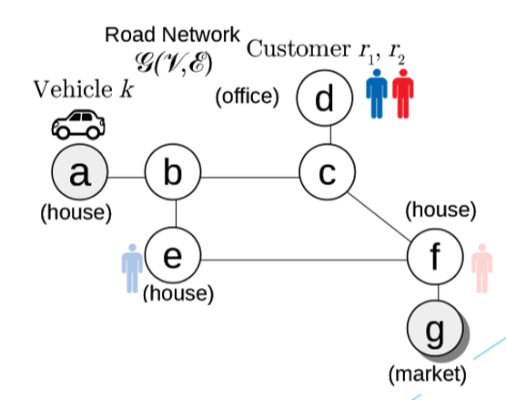
Problem Definition
Ridesharing Problem (RSP)
Vertex : Specified Places, vehicles, customers
Edge : A path between two adjacent places
James Pan, Guoliang Li, Juntao Hu.
Ridesharing: Simulator, Benchmark, and Evaluation. PVLDB 12(10):1085-1095 (2019)

Slide 16
Problem Definition
Goal
Find the minimum cost set of vehicle routes that can serve all customers.
Constraints
Precedence: A vehicle should pick up the customer at first, then go to the customer’s destination.
Time window: Both driver and customer have a time window [e, l], e < l.
Every vehicle must depart from starting position and arrive at its destination within [e, l].
It must serve the customer within the customer’s time window [e, l]
Capacities : Each vehicle’s capacity must always be positive or zero

Slide 17
Problem Definition
Real-time information : Vehicles and customers are not known beforehand.
Objective : Minimize the total route cost across all vehicles at the end of the day.
The schedule or route of a vehicle may change.

Slide 18
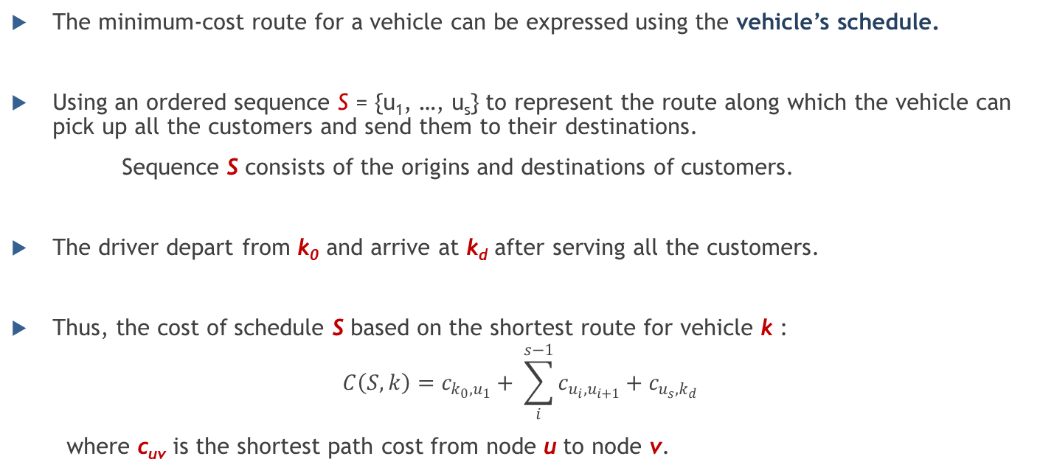
Problem Definition
The minimum-cost route for a vehicle can be expressed using the vehicle’s schedule.
Using an ordered sequence S = {u₁, …, u_{s}} to represent the route along which the vehicle can pick up all the customers and send them to their destinations.
Sequence S consists of the origins and destinations of customers.
The driver depart from k₀ and arrive at k_{d} after serving all the customers.
Thus, the cost of schedule S based on the shortest route for vehicle k :
$$C\left(S, k\right)=c_{k_{0}, u_{1}}+ \sum_{i}^{s−1}{c_{u_{i}, u_{i+1}}+c_{u_{s}, k_{d}}}$$
where c_{uv} is the shortest path cost from node u to node v.

Slide 19
Modeling
Buses : Vehicles with certain origins, destinations, capacity and also a strict time window
Passengers : Customers
Vertices : Bus stops, some crowded places and other popular venues.
Edges : Bus route between two adjacent vertices.

Slide 20
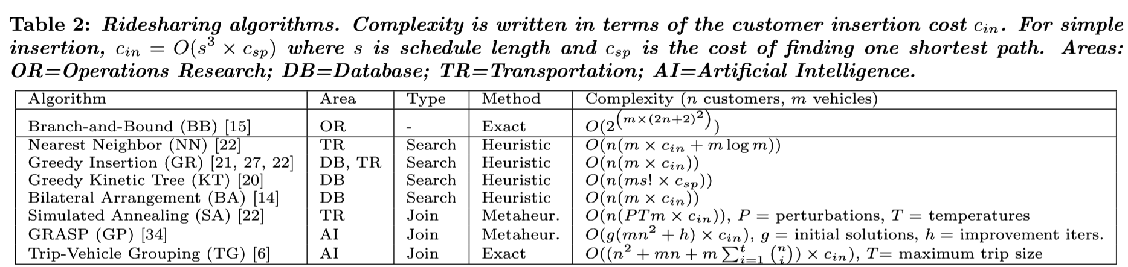
Online algorithm
James Pan, Guoliang Li, Juntao Hu.
Ridesharing: Simulator, Benchmark, and Evaluation. PVLDB 12(10):1085-1095 (2019)

Slide 21
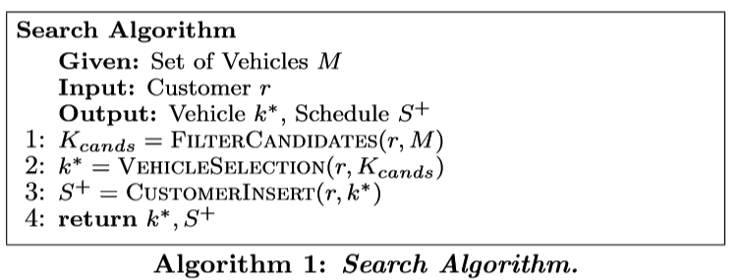
Frameworks
James Pan, Guoliang Li, Juntao Hu.
Ridesharing: Simulator, Benchmark, and Evaluation. PVLDB 12(10):1085-1095 (2019)

Slide 22
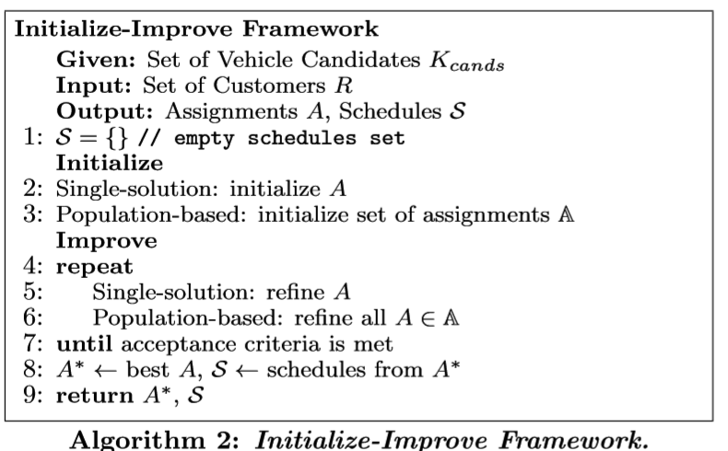
Frameworks
James Pan, Guoliang Li, Juntao Hu.
Ridesharing: Simulator, Benchmark, and Evaluation. PVLDB 12(10):1085-1095 (2019)

Slide 23
Data Collection
Basic data
Extended Data

Slide 24
Data Collection
Basic data
Necessities to form the graph
Bus stops information (#, positions, names)
Bus lines information (#, #peak Lines, property, stops, time schedule…)
Standard information of school buses (#, capacity, departure and arrival time of each bus stop with the given schedule)
The data specified above can all be retrieved by observations or talking to the managers responsible.
Necessary yet hard-to-collect data to support the simulator
James Pan, Guoliang Li, Juntao Hu.
Ridesharing: Simulator, Benchmark, and Evaluation. PVLDB 12(10):1085-1095 (2019)

Slide 25
Data Collection
Basic data
Necessities to form the graph
Necessary yet hard-to-collect data to support the simulator
Euclidean distances between bus stops
RS map / Official map SUSTech provides online
Distances of the road segments between bus stops
RS map
Distance = Speed of buses * Travelling Time
The latest time a passenger can wait until at the waiting stop, and the earliest time he/she wishes to reach the destination at. Also the latest acceptable time he/she reaches the destination. Generally, to define and fit the time window + requests from passengers
#passengers getting on the bus at the bus stop
Official class schedules and research schedules from “Teaching Affairs Office”
spread out questionnaires to passengers
Load of buses (how many passengers are on the bus)
monitors or gravity sensors on the bus
records marked by bus drivers manually
Count ourselves...

Slide 26
Data Collection
Basic data
Necessities to form the graph
Necessary yet hard-to-collect data to support the simulator
Extended Data
More functionalities (modify routes, bus stops)
Online algorithm needs real-time data
Efficiency vs. Action Latency
From school bus system to a city range
More about traffic flow status
More detailed collections of regional features

Slide 27
Task Division and time
Data: Jingran Shen;
Algorithm: Weihao Wang;
Simulator: Zhao Li.
Time: data -> simulator -> algorithm.
Backup plan: no waiting time set, bus arrives, pickup as many students and immediately goes away.

